Slide 1
eXo Content Intro
Notes:
1

Slide 2
Table of Contents
JCR Concept and Theory
Content Overview
Inline Editing
Site and Shared CSS
Sites Explorer Basics
Content Detail Portlet
One-Click Edit
Add new Content
Publish a Content
Assign a Category
Upload an Image
Content List Portlet
Fast Content Creator
Notes:
2

Slide 3
JCR Concept
Notes:
3

Slide 4
Introduction
JCR: Java Content Repository (Specification JSR 170)
Hierarchical structure
Used like a file system in eXo
All data, content and configuration is stored in the JCR.
Advances services (queries, locks, versioning,...)‏
Notes:
4

Slide 5
JCR as general Storage System
eXo uses JCR to manage all persistent data storage :
Portal Configuration (pages, navigations, preferences...)‏
eXo Content: Content, Categories, Tags
Knowledge, Collaboration, Social Features
All this data is configured in XML files and loaded in the JCR at the first start.
The JCR is available for application development, but developers are not forced to use it.
Notes:
5

Slide 6
Repositories and Workspaces
Notes:
6

Slide 7
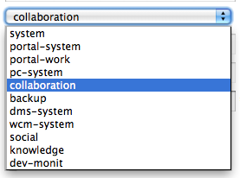
Repositories and Workspace
One or several repositories
One eXo instance only uses one repository
Multiple repositories are only used for multi-tenants (eXo Cloud).
Each repository has several workspaces
There are about 10 workspaces in eXo Platform 3.5
eXo Content data is stored in the workspace “collaboration”.
Notes:
7

Slide 8
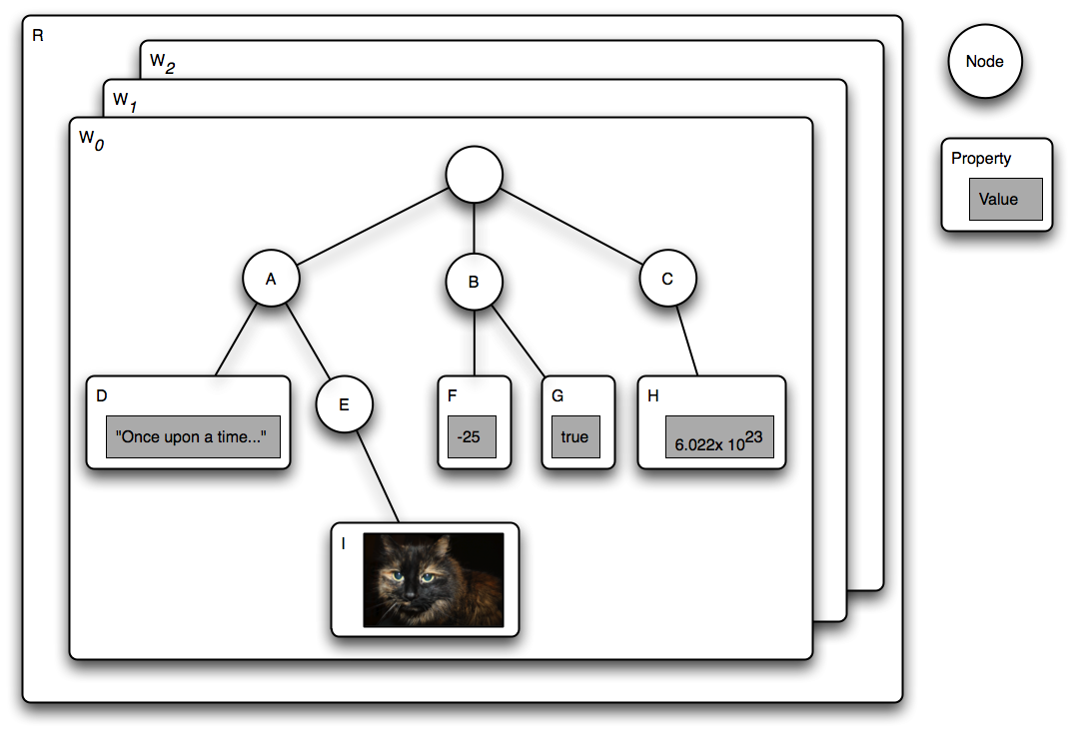
Nodes and Properties
Notes:
8

Slide 9

Nodes and Properties
Each workspace has one root node
A node can have child nodes
Each nodes has several properties
Properties can be of different types (text, binary, number, …)
Each node is of exactly one node type.
The node type defines the possible properties and possible child nodes.
Example node types: folder, file, article, news, webContent
Notes:
9

Slide 10
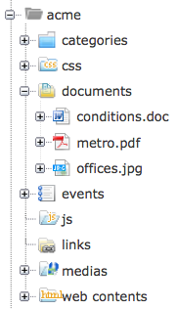
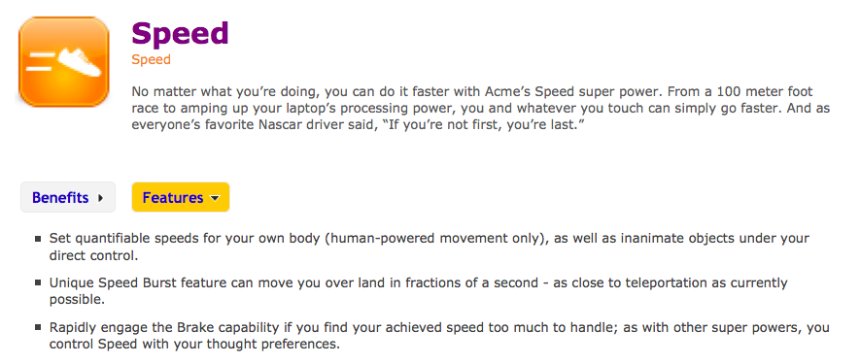
Nodes and Properties
Notes:
10

Slide 11

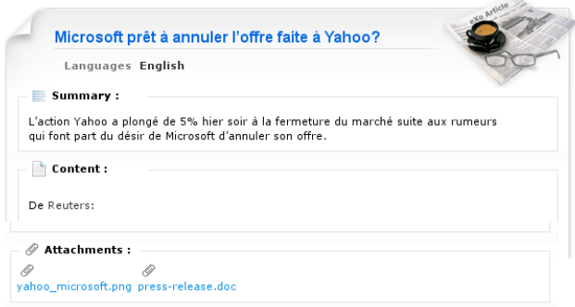
Node Example
Example exo:article
3 properties
title
summary
content
many sub-nodes files
Notes:
11

Slide 12
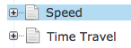
Names, Paths and Titles
Each node is identified by a “name” among its siblings (sister and brother nodes of the same parent node)
Names must not contain spaces or special characters.
Names can normally not be changed (Exception: rename interface)
The names of the all ancestors establish the path of the node
A complete path identifies a node (inside of a workspace).
Titles are normal properties used to show nice labels or titles to end users.
Notes:
12

Slide 13
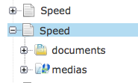
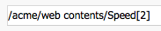
Same Name Siblings
Support for same name siblings is optional in JCR specification.
A particular node within a same-name sibling group can be addressed by embedding an array-like notation within the path.
For example the path /a/b[2]/c[3] specifies the third child node called c of the second child node called b of the node a below the root.
/a/b/c is equivalent to /a[1]/b[1]/c[1].
Always have in mind that they might be same name siblings in your system, created by end-user copy and paste in the site explorer.
Properties cannot have same name siblings.
Notes:
13

Slide 14
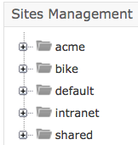
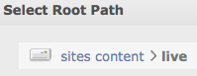
Drives
A drive gives access to a small part of a JCR workspace. A drive is a sub-tree of the whole workspace tree.
There are about 20 drives defined by default. Each drive has different access permissions.
For eXo Content, we work most of the time with the drive “Sites Management”.
The “Sites Management” drive gives access to the sub-tree “/sites content/live/” in the workspace “collaboration”. Later we will see more about this.
Notes:
14

Slide 15
Content Overview
15
Notes:
15

Slide 16

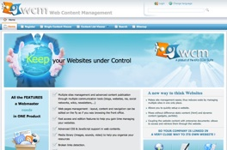
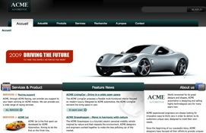
Content
Overview
Notes:
16
16

Slide 17
Content
Content:
A chunk of information that is stored on the server.
Can be shown in different portlets at different locations of WCM.
Examples:
PDF Document
Site Artifact (Banner, Footer). Site artifacts are not indexed for search.
Articles, News, Events, etc.
Any document stored on the server.
Notes:
17
17

Slide 18

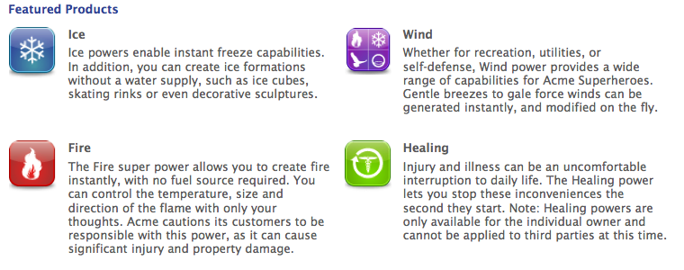
Content
Main Content Portlets:
Content Detail Portlet
Shows a single content
Content List Portlet
Shows several contents in a list
Notes:
18
18

Slide 19
Inline Editing
19
Notes:
19

Slide 20
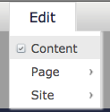
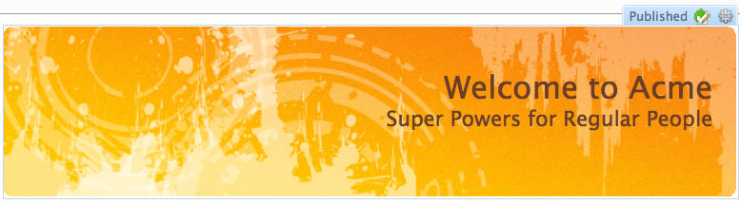
Inline Editing
1. Switch to content mode
Edit the content of the current page
1. Switch to Content Mode
2. Hover over a content and double click on a content
The content is published
2. Double click to edit
Notes:
20
20

Slide 21
Inline Editing
Preferences
Edit in Sites Explorer
Notes:
21
21

Slide 22
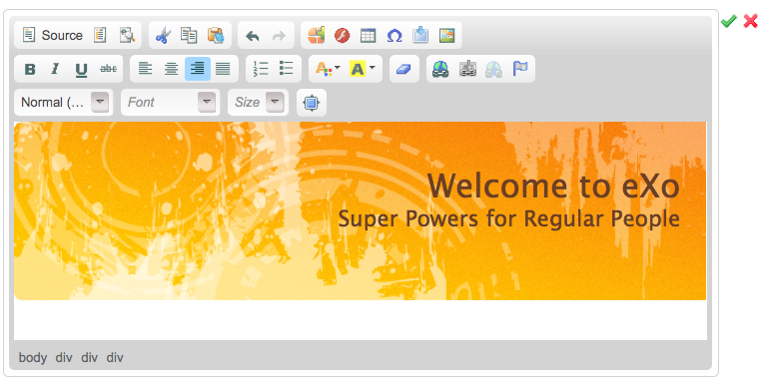
Inline Editing
Save (as draft) or Cancel
Modifying
Modification
Notes:
22
22

Slide 23
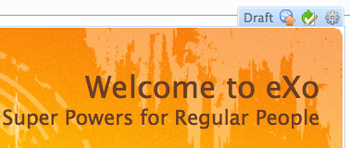
Inline Editing
Immediate Publication
Publish the content
Publication state is “Draft”
Draft Content is only visible in Content Edit Mode
Notes:
23
23

Slide 24
Exercise: Inline Editing
Inline Editing
Switch to Content Edit Mode
Double-click on the Introduce content and modify it.
Switch back to Published Mode (Uncheck Content Checkbox)
Is your unpublished modification visible?
Switch back to Content Edit Mode and publish your modification.
Extra if time : Upload a new background image for BikeIntroduce.
Notes:
24
24

Slide 25
Site CSS
25
Notes:
25
25

Slide 26
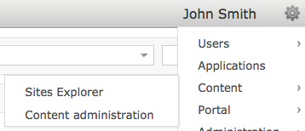
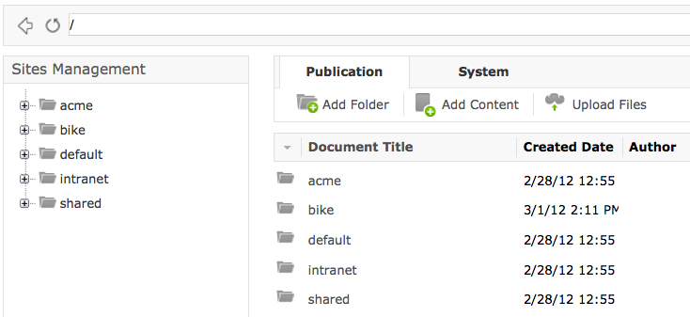
Sites Explorer – Content Explorer
Sites Explorer a.k.a Content Explorer
Notes:
26
26

Slide 27
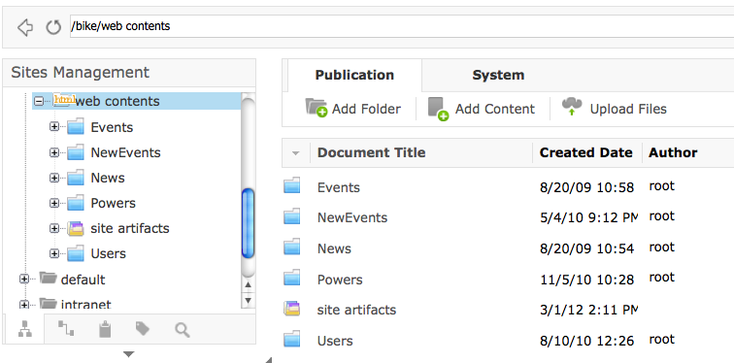
Sites Explorer
Current node
Action Buttons
Current drive
Child nodes of the current folder
Notes:
27
27

Slide 28
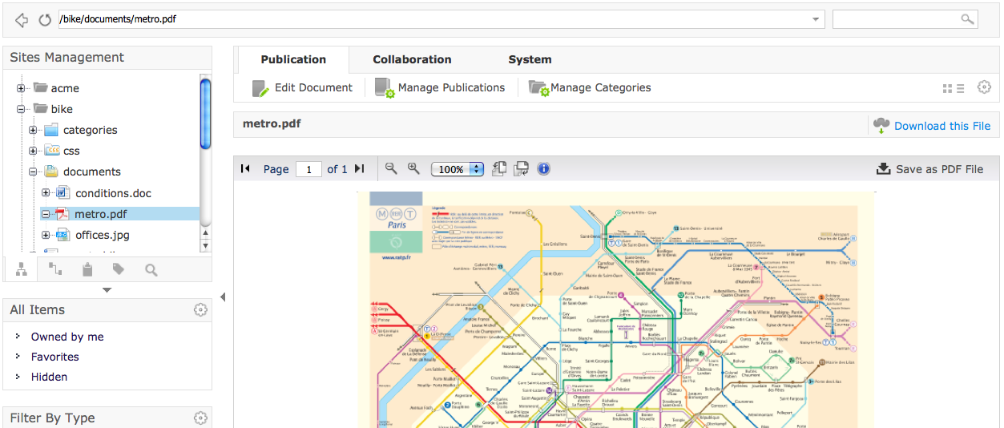
Sites Explorer
If the current node is not a folder, a viewer shows the content
There is are viewer templates for different node types.
Viewer for pdf files
Current node is a pdf
Notes:
28
28

Slide 29
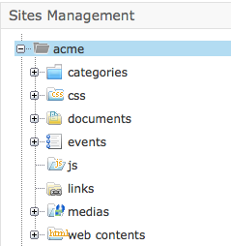
WCM Folder Structure
Categories: contains the taxonomy tree of the site
CSS: Site CSS documents
js folder: to store all shared javascripts for a website
css folder: to store all shared css for a website
documents: to store all shared documents for all webpages
media folder: to store all shared media content types (images, sounds, video) for a website
link folder: stores all shared links that a webcontent can be referred to.
Web contents folder: stores all webcontents that are used in the webpages or nodes.
A site artifacts folder: is to store all site artifacts like banner, footer.. as web content. This folder is a child of the web contents folder.
Notes:
29
29

Slide 30
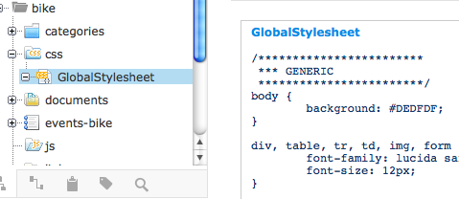
Site CSS
Notes:
30
30

Slide 31
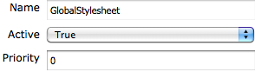
Site CSS
The site CSS is only applied to one site (acme, intranet,…)
The site CSS has priority over other CSS files.
That way, you can override prior CSS rules.
There can be several stylesheets for one site
In case of several stylesheets: The order is defined by the “priority” parameter. (0=highest priority ) When rendering site pages, all stylesheets are merged into one file taking into account the priorities.
All stylesheets are in the subfolder css of your site (acme/css/yourStylesheet.css)
Notes:
31
31

Slide 32
Shared Site CSS
The shared site CSS is applied to all sites (acme, intranent,…)
The site CSS can override rules of the shared CSS.
The shared stylesheet is in the subfolder css of the shared site (shared/css/yourSharedStylesheet.css)
When you open the source html of a page of acme you will see that the shared stylesheet file is included before the acme stylesheet file.
Notes:
32
32

Slide 33
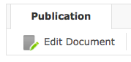
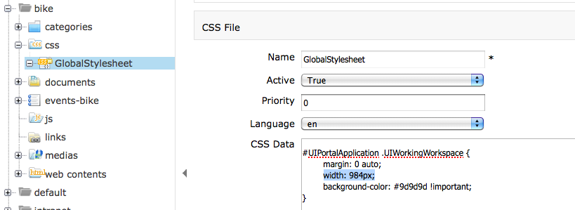
Bug Correction: Delete Width in Style Sheet
Remove
Notes:
33
33

Slide 34
Exercise: Site CSS
Login as john. Open the Acme site. Open the Site Explorer
Correct the Admin Tool Bar Bug: Open /bike/css/GlobalStylesheet, search the “#UIPortalApplication” rule and delete the entry “width: 984px”.
Open the drive Sites Management. Then open /shared/css/
Add a new stylesheet with a visible rule: p {margin: 50px}
Activate your CSS and give it a low priority (0)
Add a new site CSS in /bike/css/
Add the same visible rule with a different value: p {margin: 200px}
Activate your CSS and give it a low priority (0)
Extra: Open the source html of acme analyze the order of included stylesheets. Observe how several site stylesheets are merged.
Notes:
34
34

Slide 35
Sites Explorer
35
Notes:
35

Slide 36
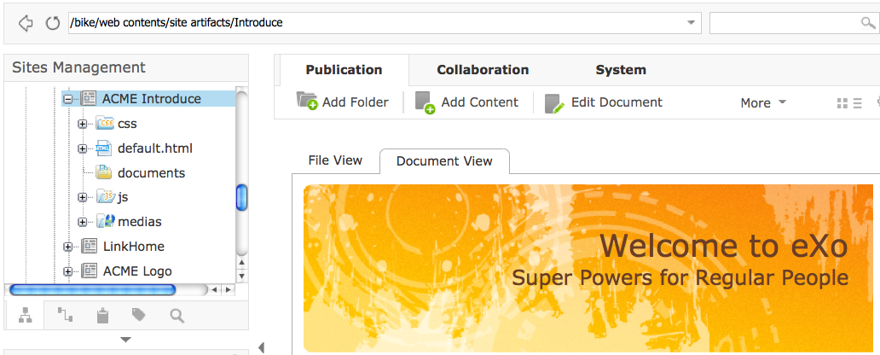
Sites Explorer: View of a node type
The node type of the current node is “web content”
View template for a “web content” node type renders the content
Notes:
36
36

Slide 37
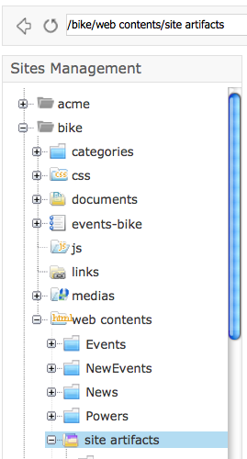
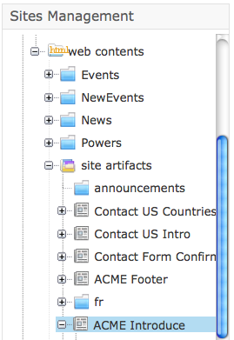
Copy, Rename, Edit (Sites Explorer)
Path to folder
Content
Notes:
37
37

Slide 38
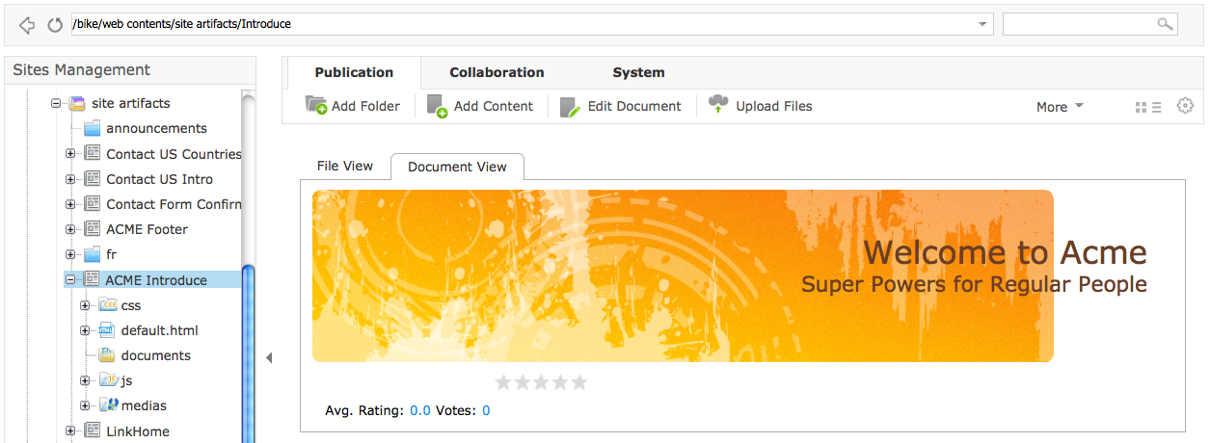
Copy, Rename, Edit Content
Path of the content
Position of the content
“View” of this noder type (document type)
Notes:
38
38

Slide 39
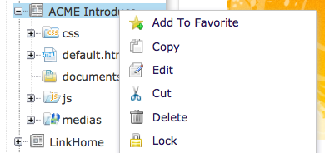
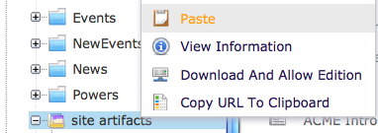
Copy and Paste
1. Hover over the content and select copy.
2. Before paste, be sure to select a folder!
Notes:
39
39

Slide 40
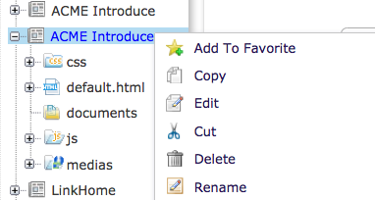
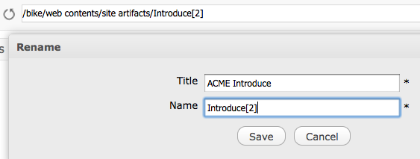
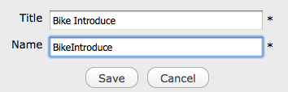
Rename
Index for the second sibling
Same name siblings, rename the 2nd sibling
Notes:
40
40

Slide 41
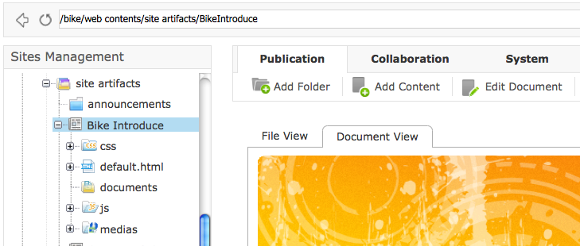
Edit Content
1. Select the renamed node
2. Action buttons are executed on the selected node
Notes:
41
41

Slide 42
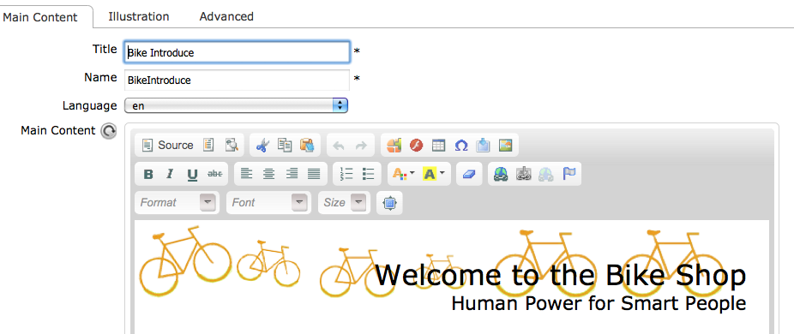
Web Content Dialog
Title for the public
Internal name/id
Toolbar of the CK Editor
Notes:
42
42

Slide 43
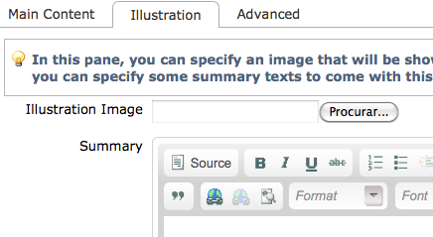
Web Content Dialog
Editing
Prepare the information for the Content List Portlet (later chapter)
Set Image and/or summary which are shown in content lists.
Notes:
43
43

Slide 44
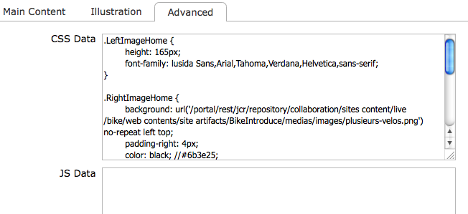
Web Content Dialog
CSS and JS for this content
Notes:
44
44

Slide 45
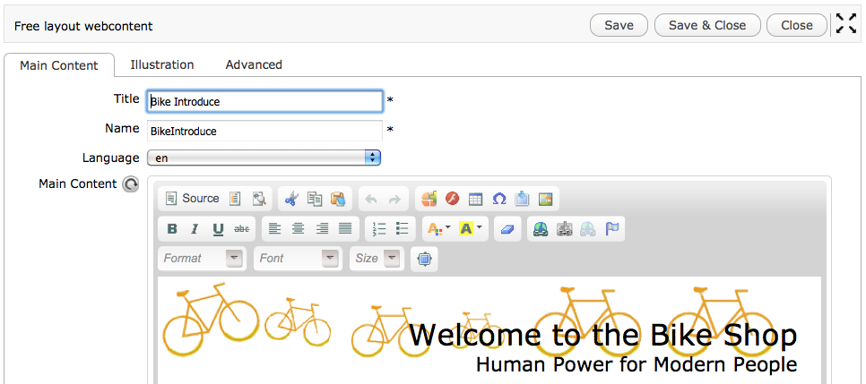
Edit Content
Modify the content and Save
Notes:
45
45

Slide 46
Exercise: Sites Explorer
Do everything from the previous slides!
Login as john. Open the Sites Explorer (Tools -> Content -> Sites Explorer)
Find the Acme Introduce article, copy it and rename the copy to “BikeIntroduce” (Path: /bike/web contents/site artifacts/Introduce)
Modify BikeIntroduce
We will use this content in the next chapter in a Content Detail Portletr.
Notes:
46
46

Slide 47
Content Detail Portlet
47
Notes:
47

Slide 48
Content Detail Portlet
Formerly known as Single Content Viewer (SCV)
Shows a single content in the portlet.
The content is defined by a path.
Notes:
48
48

Slide 49

Content Detail Portlets
Content Detail Portlet is used everywhere
Notes:
49
49

Slide 50
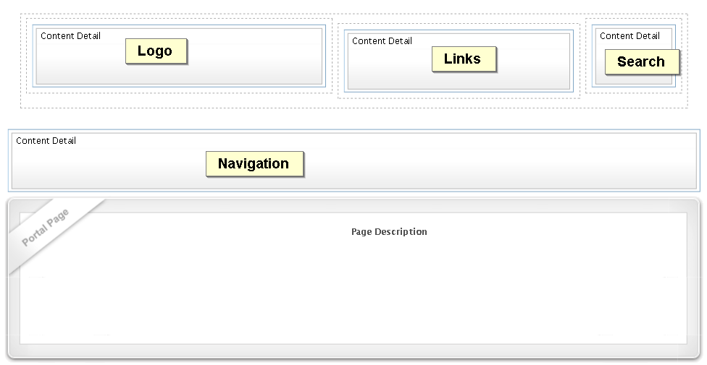
Content Detail Portlets
Notes:
50
50

Slide 51
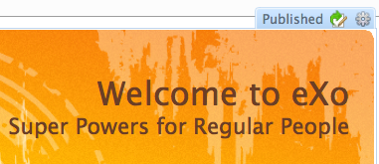
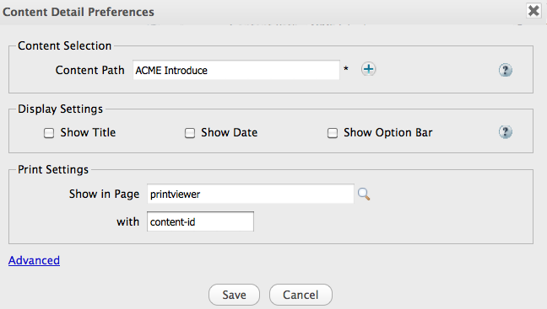
Content Detail Portlet Preferences
Path to the content
Check them all for testing
Notes:
51
51

Slide 52
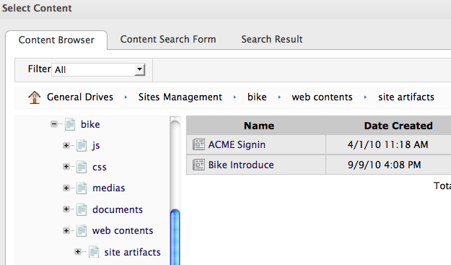
Content Detail Portlet Preferences
Always use General Drives – Sites Management
A drive gives you access to a small part of the JCR node structure
Click on the content
Notes:
52
52

Slide 53
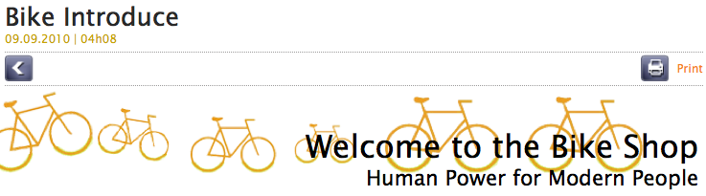
Result
The portlet points now to the BikeIntroduce content
Notes:
53
53

Slide 54
Exercise: Content Detail Portlet
Content Detail Portlet
Login as john (all passwords are “gtn”)
Open the Bike home page.
Change to Content Mode.
Open the Content Detail Portlet for the Introduce content and point to the BikeIntroduce article you have created in the last exercise.
The path was: /bike/web contents/site artifacts/BikeIntroduce
Check the checkboxes of the Content Detail Portlet
Notes:
54
54

Slide 55
One-Click Edit
55
Notes:
55

Slide 56
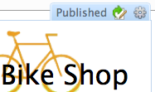
One-Click Edit
Notes:
56
56

Slide 57
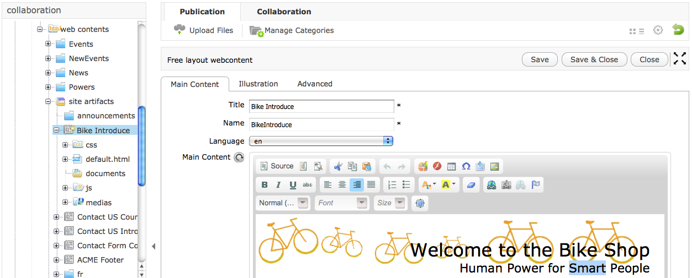
Content Editor
1. Open
Position in the site explorer
4. Jump back to the web page
3. Save
2. Modification
Notes:
57
57

Slide 58
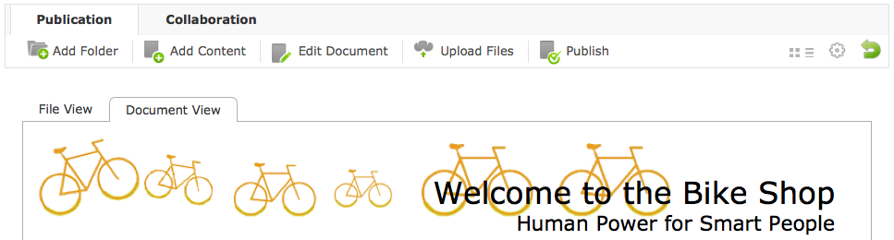
Content Editor
The Publish button appears because the content has been modified after the last publication.
Jump back to the home back
Modification
Notes:
58
58

Slide 59
Exercise: One-Click Edit
Content Detail Portlet
Login as john, switch to Content Edit Mode.
Open the bike home page.
Hover over the “Introduce” article and click on the edit icon.
Modify the content and click on the green back arrow in order to see the bike home page again.
Notes:
59
59

Slide 60
Site Explorer – Add new Content
60
Notes:
60

Slide 61
Sites Explorer
Sites Explorer a.k.a Content Explorer
Notes:
61
61

Slide 62
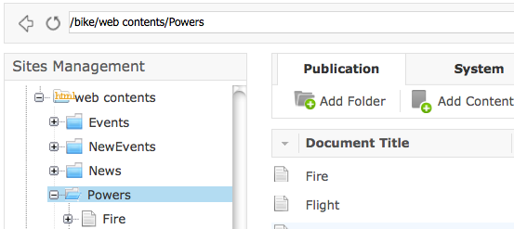
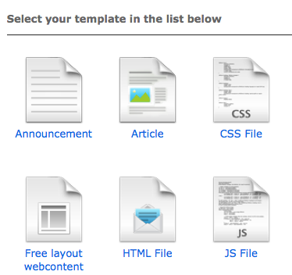
Sites Explorer – Add Content
2. Click on “Add Content”
1. Open the “Powers” folder
3. Choose the document type “article”
Notes:
62
62

Slide 63

Sites Explorer – Add Content
This is the dialog of the document type “article”
Notes:
63
63

Slide 64

Sites Explorer – Add Content
This is the “view” of the document type “article”
Notes:
64
64

Slide 65
Publication
65
Notes:
65

Slide 66
Publication
Publication
For each document, you can choose among different publication lifecycles.
If necessary, developers can create custom publication lifecycles.
Each document is in exactly one lifecycle, you cannot switch the lifecycle.
Notes:
66
66

Slide 67


Draft and Published
Save the modifications does not publish automatically.
The state of the modifications is “draft”.
The public still sees the last published version.
Updates are visible in Content mode but not in “Published” mode.
In “Content” mode, non-published documents are marked as “Draft”.
“Draft” and “Published” correspond to two states in the “Publication Lifecycle”.
Notes:
67
67

Slide 68

Manage Publications
Publication lifecycle
Notes:
68
68

Slide 69

Manage Publications
Click on Published, the buttons depend on permissions
Publication revisions
Notes:
69
69

Slide 70

Manage Publications
“Staged” means “ready for publication”, a scheduler will publish the content automatically.
Publication start and end dates
Notes:
70
70

Slide 71

Manage Publications
Notes:
71
71

Slide 72
Assign a Category
72
Notes:
72

Slide 73

Assign a Category
Category trees
Categories inside of the tree “acme”
Notes:
73
73

Slide 74

Assign a Category
Notes:
74
74

Slide 75

Result: Published Article in Defense Category
Notes:
75
75

Slide 76
Exercise: New Content, Publication, Categories
Do everything from the previous slides!
Create a new site called “bike” - if you haven’t yet.
Open the Sites Explorer (Tools -> Content -> Sites Explorer).
Open “/bike/web contents/Powers” and create a new article of the node type “article” called Bicycle, copy and paste the wikipedia article about bicycles.
Open “Manage Publications” for the article “Bicycle” and publish it.
Open “Manage Categories” and add “Bicycle” to “acme/Defense” and “acme/Movement”.
Go to the home page, hover over the products navigation entry and click on “Bicycle”.
Notes:
76
76

Slide 77
Exercise: Draft and Publish
Draft and Publish
Login as John. Open the Bike site.
Switch to Content mode.
Modify a Content Detail Portlet and click on “Save”. Go back to the homepage (green arrow). Click on the button “Publish”.
Switch to “Content” mode. As the content is published, the modifications are always visible.
Modify the content again and click on “Save”. Do not publish it. Go back to the homepage.
Switch between “Content” and “Published” mode and see how the published and draft content differs.
Notes:
77
77

Slide 78
Upload an Image
78
Notes:
78

Slide 79


CK Editor Upload Image
Insert image
Notes:
79
79

Slide 80

CK Editor Upload Image
Upload an image
Notes:
80
80

Slide 81


CK Editor Upload Image
Notes:
81
81

Slide 82

Assign a new Image
A new image for the Logo
Switch to Content Edit Mode
Hover over the Company Logo and open it in the sites explorer.
Edit the content, click on the image icon.
Click on “Browse Server”.
Open the folder /bike/medias/images
Upload Michauxjun-wikipedia.jpg to this folder.
Save & Close and publish the modifications.
Test
Notes:
82
82

Slide 83
Extra: Assign a new Image in CSS
A new image for BikeIntroduce
Different steps, nearly same result.
Open BikeIntroduce in the sites explorer.
Open the …/medias/images subfolder. /bike/web contents/site artifacts/BikeIntroduce/medias/images
Upload bike-shop.png to this folder.
Open the BikeIntroduce again. In the css tab modify the path to “/portal/rest/jcr/repository/collaboration/sites content/live/bike/web contents/site artifacts/BikeIntroduce/medias/images/bike-shop.png”
Save&Close the css and Publish the modifications.
Test
Notes:
83
83

Slide 84
Content List Portlet
84
Notes:
84

Slide 85

Content List Portlets
Content List Portlets
Notes:
85
85

Slide 86

Content List Portlet
Add new content to this list
Browse the folder in the sites explorer
Open Portlet Preferences (Edit Mode)
Edit this content
3 contents per page from the News folder
A single content
Notes:
86
86

Slide 87

Content List
Show the content as list from a folder
Select folder from any folder (content, taxonomy, ...)
Choose a viewer and a paginator template
Select display options
Title
Header
Summary
Date
Image
Link
Notes:
87
87

Slide 88
Content List
Contents of the News folder
Notes:
88
88

Slide 89


Content List – Select a Folder
Choose the parent folder on the left panel.
Then click on the content folder on the right panel.
Notes:
89
89

Slide 90


Content List – Select a template
Modification of the header, template, paginator and items per page.
Different template, 2 items per page
Content of the Events folder
Paginator
Notes:
90
90

Slide 91

Exercise: Content List
Open the Bike site and repeat the previous slides. Modify the Content List Portlet so that it points to /bike/web contents/events/
Feel free to play around with the other options:
Notes:
91
91

Slide 92
Forms
92
Notes:
92

Slide 93


Standard Content Creator

Slide 94


Standard Content Creator

Slide 95


Standard Content Creator

Slide 96
Exercise: Standard Content Creator
For the administrator group, create a new page. For that, you have to open the page “Add Users” first.
Drag a “Standard Content Creator“ to the page.
Modify the settings of this application: use the dialog of the “event” node type. The path to store new contents should be “/sites content/live/bike/web contents/events/”
Create new events using the form.
The new events are stored in the same folder where the Content List Portlet reads from. Do the new events appear in the Content List showing the events? Try out the Content Edit Mode and publish the new events?

Slide 97
eXo Content Intro
Notes:
97

